Slide 1


Serverless Computing
How's, what's and why's

Slide 2
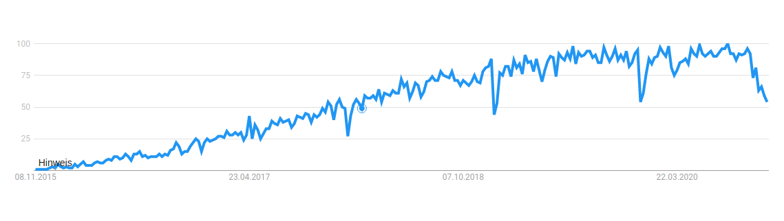
Popularity
Google search term popularity of "serverless"

Slide 3
Popularization
2014
Amazon AWS Lambda "re:Invent"
Galactic Fog Gestalt Laser
2016
Google Cloud Functions
Microsoft Azure Functions
IBM OpenWhisk
Auth0 Webtask
Iron.io IronWorker
2013

Slide 4
Distinction
Serverless Architecture
Serverless Network File System
Serverless Computing

Slide 5
Definition
Cloud computing execution model
Cloud provider runs the server and
Dynamically manages machine resources
Deployment of stateless functions

Slide 6
Developer Control
Hardware/VM Deployment
Custom infrastructure
Custom application code
Shared application code
Full stack services (SaaS)
Shared infrastructure
Serverless
Less Control
More Control

Slide 7
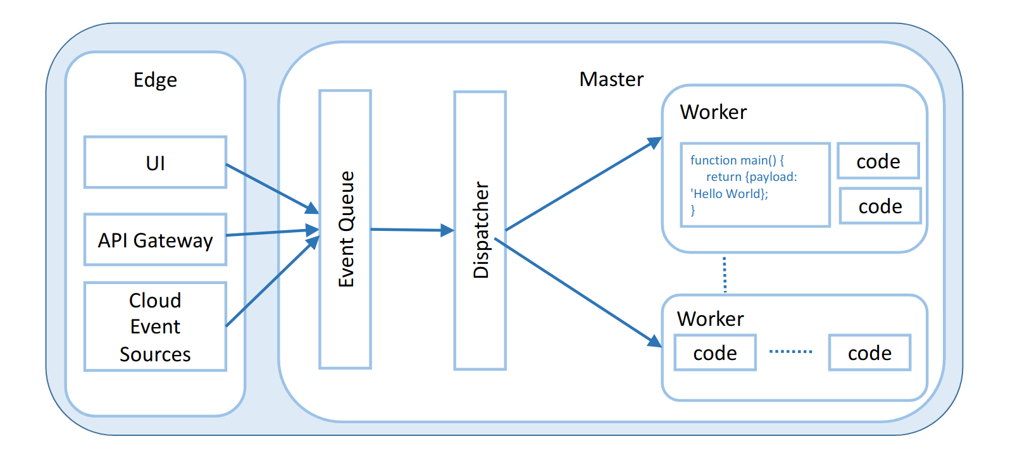
Architecture
General unspecific platform architecture

Slide 8

Internal Architecture
Based on Containers
That means shared kernel
Function adds last layer
Or mounted if interpreted language
Compiled languages slow first invocation, fast after
Interpreted languages fast first invocation, not as fast after
Multi-Tenant

Slide 9
Characteristics
Cost
Performance and limits
Programming languages
Composability
Deployment
Security and accounting
Monitoring and alerting

Slide 10
Benefits
Optimise function by cost (rather than by latency, scalability, and elasticity)
No longer manage server or infrastructure
Stateless functions enable provider (to patch server or move tenant, no need to wait)

Slide 11

Drawbacks
Maybe too constraining for some applications (language, stateless, hardware, …)
Risk of vendor lock-in (if additional features like reporting, … are used in conjunction)

Slide 12
Use Cases
Bursty, compute intensive workload
Avoid IO operations

Slide 13
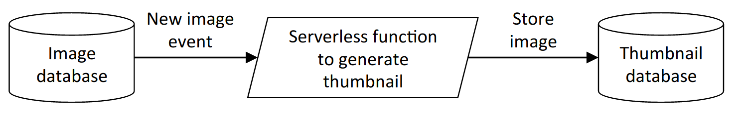
Event processing
Hello World of AWS Lambda: Event driven image processing

Slide 14
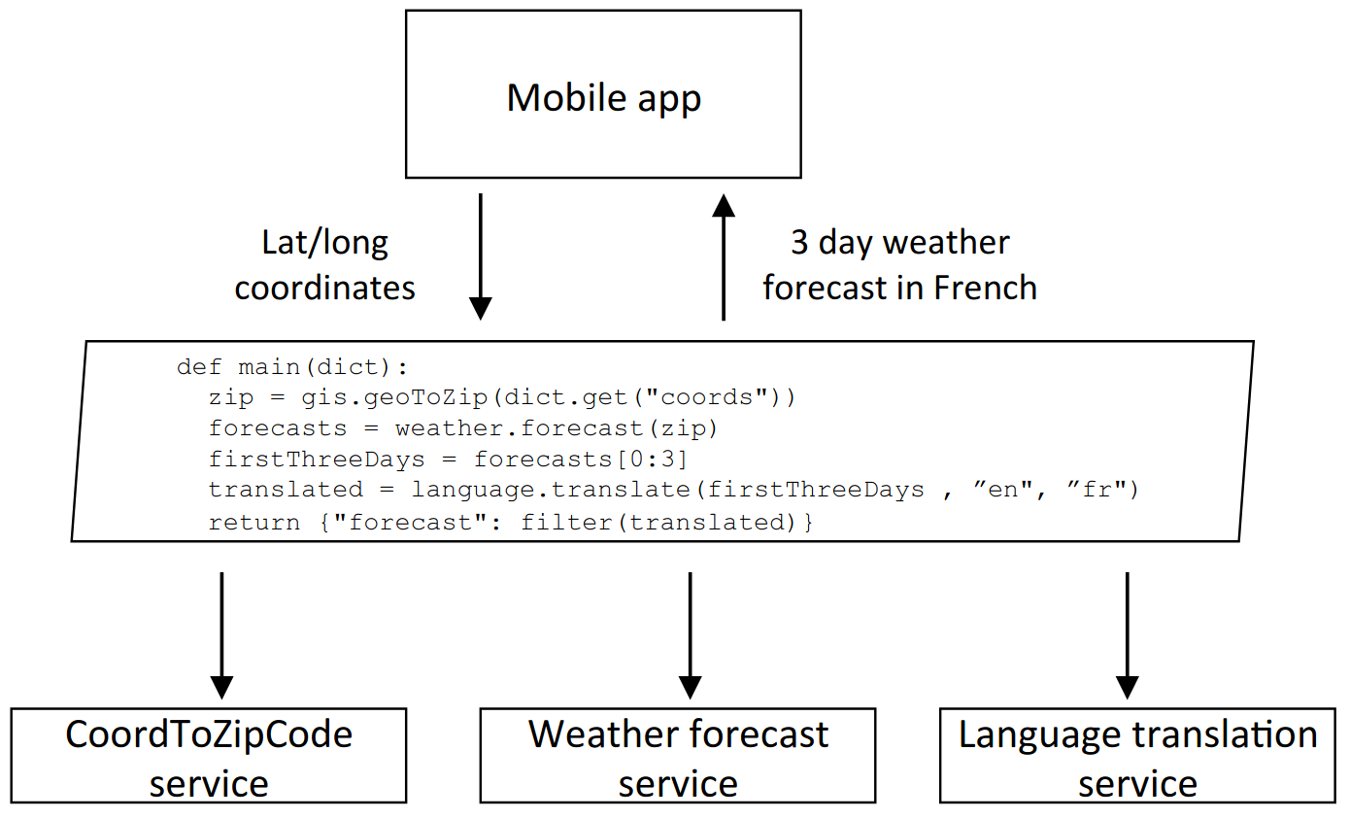
API composition
Offloading API calls
and glue logic from mobile app to backend

Slide 15
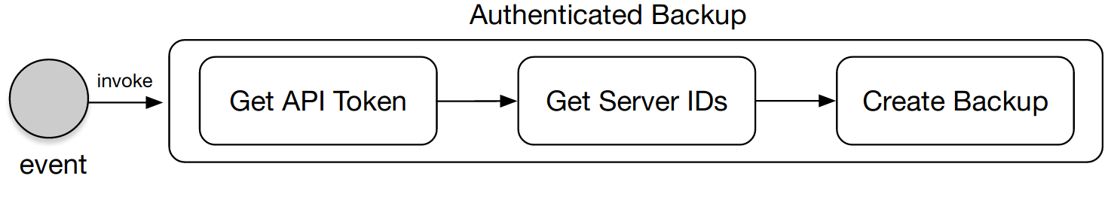
API aggregation
Reducing the number of API calls required for a mobile client

Slide 16
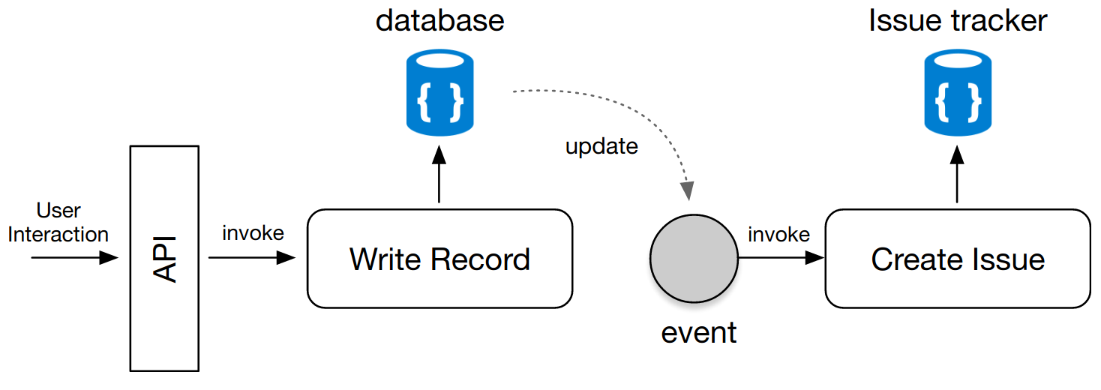
Flow control
Batched invocation for issue tracking

Slide 17

Different Eco Systems

Slide 18
Comparison
 | AWS Lambda | Microsoft Azure | Google Cloud Functions
Memory (MB) | 64 * k in (2,...,47) | 1536 | 128 * k in (1,…,32)
CPU | Proportional to Memory | Unknown | Proportional to Memory
Language | Node, Python, Ruby, Java, Go, .Net Others via custom runtime | C#, Java, JavaScript, TypeScript, Python, Powershell | Nodejs, Python, Go, Java
Runtime OS | Amazon Linux | Windows 10, Linux | Debian 8
Local disk (MB) | 512 | 500 | > 512
Timeout (sec) | 900 (configurable from default: 3) | 600 | 540 (configurable from default: 60)
Billing factor | Execution time Allocated memory | Execution time Consumed memory | Execution time Allocated memory Allocated CPU

Slide 19

Many other:
IBM OpenWhisk
Iron.io Ironworker
Auth0 Webtask
Galactic Fog Gestal Laser
…

Slide 20

Performance and Price Comparison
4 short examples

Slide 21
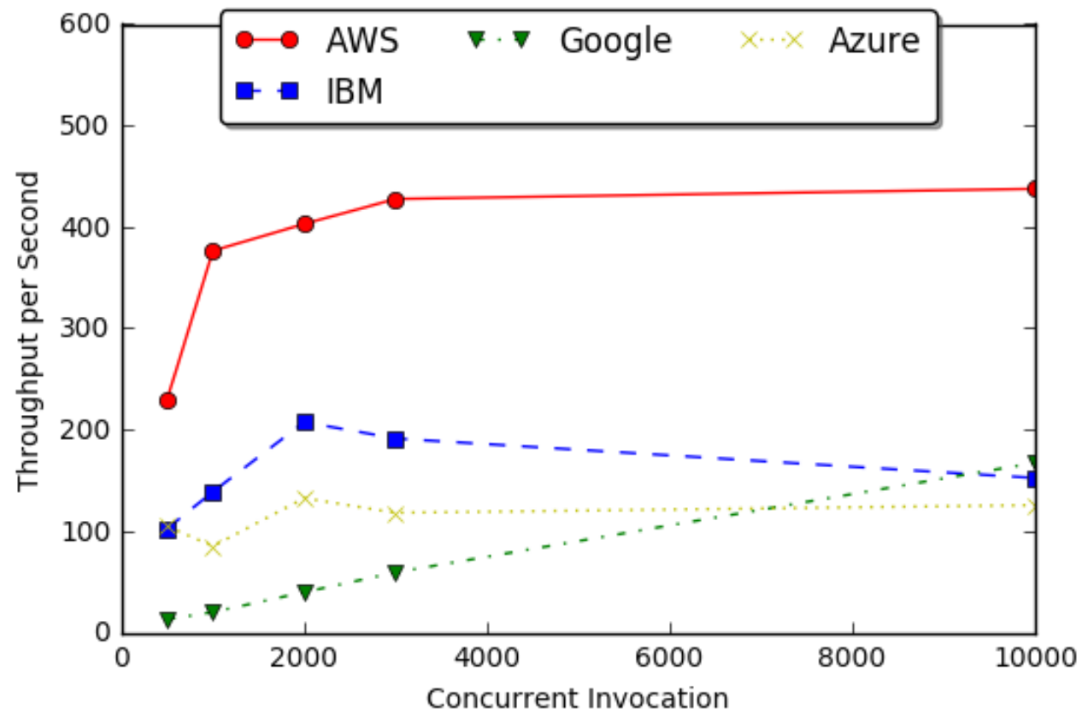
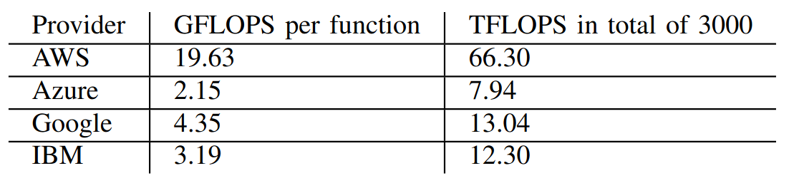
Function Throughput on Concurrent Invocations
CPU Performance

Slide 22
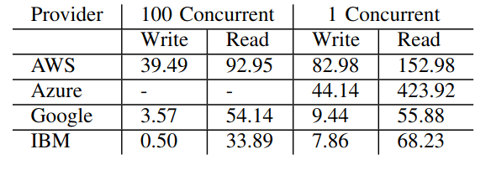
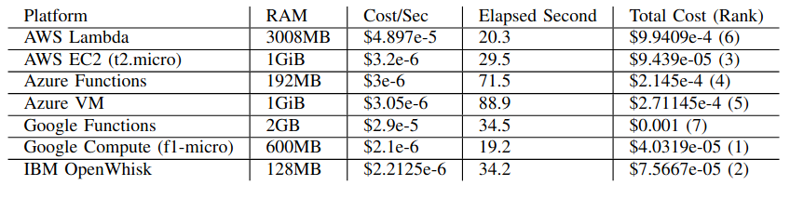
Median Write/Read Speed (MB/s)
Building Binary Tree with Cost-Awareness

Slide 23
Examples
(only AWS Lambda)

Slide 24

Getting started on AWS Lambda
That’s it!
Register AWS Account (CreditCard needed)

Slide 25
Example 1
AWS Lambda Console
AWS Lambda Designer

Slide 26
Example 2
Installing AWS CLI
Creating HelloWorld

Slide 27
Example 4
Kotless

Slide 28
Example 3
AWS Toolkit Plugin
(here: IntelliJ)

Slide 29
Example 4
Kotless

Slide 30
Further Read
AWS Whitepaper:
https://d1.awsstatic.com/whitepapers/serverless-architectures-with-aws-lambda.pdf
Any of the mentioned resources
Google scholar: `Serverless Computing`
Resources and examples of this Github repo:
https://github.com/HartmannS/serverless_presentation

